Slide 1

Chandigarh School of Business, Jhanjeri
Department of Computer Application
Program Code: NA
Program Name: MCA
Course Code: PGCA1937
Course Name: Cloud Computing
Prepared by: Dr. Gurvir Kaur

Slide 2

Outlines
PTU Syllabus of Unit-I
CO’s Introduction
Topic Overview
Brief description of what the presentation will cover
Importance or relevance of the topic
Key objectives or learning outcomes
Summary
References

Slide 3
PTU Syllabus of Unit-I
Part-A
Overview of Computing Paradigm: Recent trends in Computing -Grid Computing, Cluster Computing, Distributed Computing, Utility Computing, Cloud Computing.
Introduction to Cloud Computing: Vision of Cloud Computing, Defining a Cloud, Cloud Reference Model, Deployment Model, Characteristics, Benefits of Cloud Computing, Challenges ahead. Cloud computing vs. Cluster computing vs. Grid computing.
Migrating into a Cloud: Introduction, Broad approaches to Migrating into the Cloud, The Seven-Step Model of Migration Into a Cloud.
Virtualization: Introduction, Characteristics of Virtualized environment, Taxonomy of Virtualization techniques, Virtualization and Cloud Computing, Pros and Cons of Virtualization, Technology Examples- Xen, VMware, Microsoft Hyper-V.
Capacity Planning: Introduction, Defining Baseline and Metrics-Baseline Measurements, System Metrics, Load Testing, Resource Ceilings, Server and Instance types; Network Capacity, Scaling.

Slide 4
Key objectives or learning outcomes
CO1 Understand the basic concept and importance of cloud computing.
CO2 Access the suitability of migrating to a cloud solution for different applications.
CO3 Compare and evaluate the virtualization technologies.
CO4 Monitor and manage the cloud resources, applications and data while addressing the security concerns.
CO5 Use cloud solutions offered by industry leaders for various applications.

Slide 5
CO Introduction
CO NUMBER | TOPICS | LEVEL
CO2 | Migrating into a Cloud: Introduction, Broad approaches to Migrating into the Cloud, The Seven-Step Model of Migration Into a Cloud. Virtualization: Introduction, Characteristics of Virtualized environment, Taxonomy of Virtualization techniques, Virtualization and Cloud Computing, Pros and Cons of Virtualization, Technology Examples- Xen, VMware, Microsoft Hyper-V. Capacity Planning: Introduction, Defining Baseline and Metrics-Baseline Measurements, System Metrics, Load Testing, Resource Ceilings, Server and Instance types; Network Capacity, Scaling. | 2

Slide 6
Topic Overview
Migrating to the cloud enables businesses to scale, reduce costs, and leverage advanced technologies like AI and analytics.
The process involves assessing current systems, choosing the right cloud model (public, private, or hybrid), and executing migration strategies like rehosting or rearchitecting.
Key benefits include flexibility, improved performance, and enhanced disaster recovery.
However, challenges like security, compliance, and cost management must be addressed for a successful transition.

Slide 7
Brief of what the presentation will
The presentation will cover the following points:
Migrating into a Cloud:
Introduction,
Broad approaches to Migrating into the Cloud,
The Seven-Step Model of Migration Into a Cloud.

Slide 8
Importance of the topic
Scalability and Flexibility:
Cloud migration allows businesses to scale resources up or down based on demand, ensuring agility and efficiency while reducing dependency on physical infrastructure.
Cost Optimization:
Shifting to the cloud reduces capital expenditure by transitioning to a pay-as-you-go model, optimizing operational costs, and eliminating the need for hardware maintenance.
Enhanced Performance and Innovation:
Cloud platforms provide faster performance, global accessibility, and access to advanced technologies like AI, big data, and automation, driving innovation and competitive advantage.

Slide 9
Detail Topics
Migrating to the cloud is crucial for scalability, enabling businesses to adapt quickly to changing demands while optimizing resource usage.
It reduces costs by shifting from capital expenses to a pay-as-you-go model and eliminating hardware maintenance. Cloud platforms enhance performance and accessibility, supporting global operations and seamless collaboration.
Additionally, they provide access to cutting-edge technologies like AI and analytics, fostering innovation and growth.

Slide 10
Cloud Migration?
A cloud migration is when a company moves some or all of its data center capabilities into the cloud, usually to run on the cloud-based infrastructure provided by a cloud service provider such as AWS, Google Cloud, or Azure.
Questions
When and how to migrate one’s application into cloud?
What part of the IT application to migrate into a cloud?
What not to migrate into a cloud?
What kind of customers really benefit from migrating their IT into the cloud?

Slide 11
Cloud Migration
Definition: Transitioning workloads, applications, and data from on-premises to the cloud.
Importance: Scalability, cost-efficiency, and access to modern technology.
Key Drivers: Flexibility, performance, and competitive advantage.

Slide 12
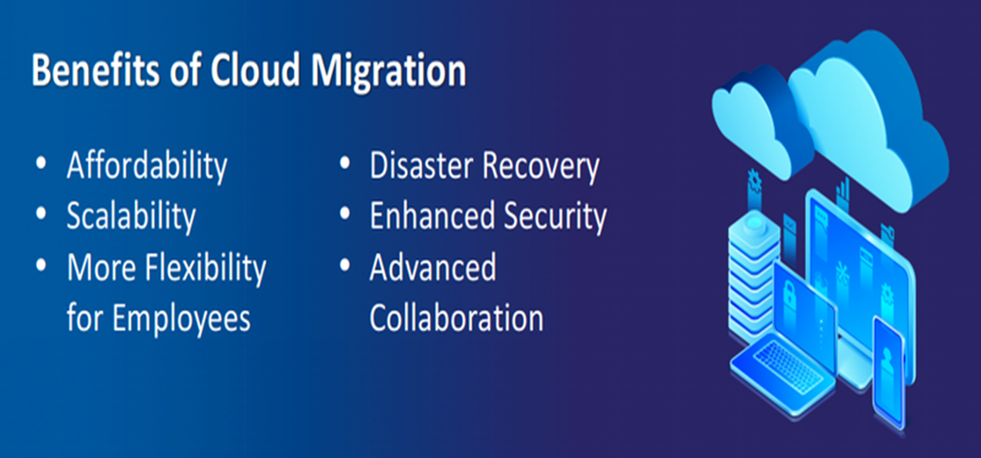
Benefits of Cloud Migration
Scalability and flexibility.
Cost optimization (CapEx to OpEx).
Global reach, disaster recovery, and innovation opportunities.

Slide 13
Broad Approaches to Cloud Migration?
Rehosting ("Lift and Shift"): Migrating applications as-is with minimal changes.
Replatforming: Optimizing applications for the cloud without major changes.
Rearchitecting: Redesigning applications to leverage cloud-native features.
Repurchasing: Moving to a new cloud-based solution (e.g., SaaS).
Retiring/Retaining: Decommissioning outdated apps or keeping them on-premises.

Slide 14
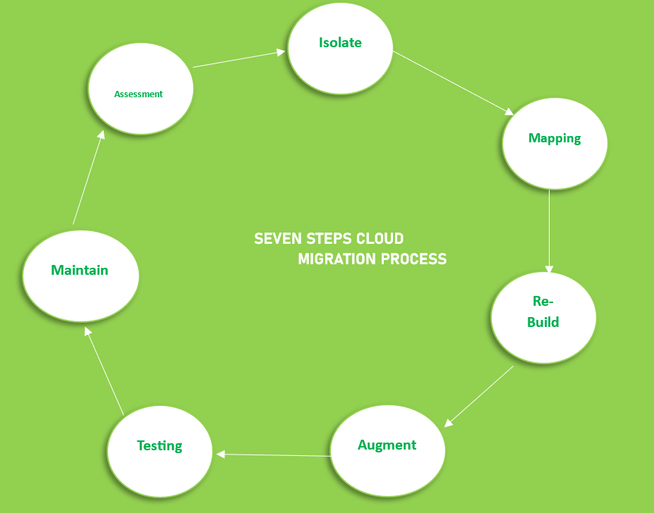
Seven-Step Migration Model

Slide 15
Continue
Step 1: Choose the right cloud provider ( Assessment step)
The first step in migrating your model to the cloud is to choose a cloud provider that aligns with your needs, budget, and model requirement. consider the factors such as compliance, privacy, and security.
Step 2: Prepare your data ( Isolation step)
Before migrating to your cloud, you need to prepare your data. for that ensure your data is clean and well organized, and in a format that is compatible with your chosen cloud provider.

Slide 16
Continue
Step 3: Choose your cloud storage ( Mapping step)
Once your data is prepared, you need to choose your cloud storage. This is where your data is stored in the cloud. there are many cloud storage services such as GCP Cloud Storage, AWS S3, or Azure Blob Storage.
Step 4: Set up your cloud computing resources and deploy your model(Re-architect)
If you want to run a model in the cloud, you will need to set up your cloud computing resources. This includes selecting the appropriate instance type and setting up a virtual machine(VM) or container for your model.

Slide 17
Continue
Step-5: Augmentation step
It is the most important step for our business for which we migrate to the cloud in this step by taking leverage of the internal features of cloud computing service we augment our enterprise.
Step 6: Test your Model
Once your model is deployed, we need to test it to ensure that it is working or not. That involves running test data through your model and comparing the results with your expected output.

Slide 18
Continue
Step 7: Monitor and maintain your Model
After the model is deployed and tested, it is important to monitor and maintain it. That includes monitoring the performance, updating the model as needed, and need to ensure your data stays up-to-date.
Migrating your machine learning model to the cloud can be a complex process, but above 7 steps, you can help ensure a smooth and successful migration, ensuring that your model is scalable and accessible.

Slide 19
Summary
Summary of cloud migration's importance, approaches, and seven-step model.
Emphasize strategic planning and continuous optimization for success.
Call to action: Explore cloud solutions to unlock business potential.

Slide 20
References
Books References
Mastering Cloud Computing, Rajkumar Buyya, Christian Vecchiola, and ThamaraiSelvi, Tata McGraw Hill, ISBN-13: 978-1-25-902995-0, New Delhi, India,Feb 2013.
E-book link
https://archive.org/details/cloudcomputingbi0000sosi
YouTube link
https://www.youtube.com/@cloudcomputing351/videos
https://www.slideshare.net/slideshow/cloud-migration-presentation-246744264/246744264?from_action=download&slideshow_id=246744264&original_file=true
https://www.geeksforgeeks.org/7-steps-of-migrating-model-in-cloud/
https://nptel.ac.in/courses/106105167
https://www.edx.org/learn/cloud-computing

Slide 21
THANK YOU

